Slide 1

CS6611 - CREATIVE AND INNOVATIVE PROJECT
PROJECT GUIDE : Dr. Angelin Gladston
Generating 3D models from biomedical images
via volumetric segmentation
TEAM 25
S SOWMIYA SREE
JUANITA J

Slide 2
Abstract
The prime idea is to generate a workflow that can be used to convert volumetric medical imaging data (MRI and CT images) to 3D models. Our work focuses on implementing advanced segmentation algorithms which would be capable of detecting smaller structures and separate boundary regions precisely (patient specific). We propose a convolutional architecture for volumetric segmentation. The volumetric segmentation is followed by mesh refinement which focuses repairing, smoothing and appending with other related segments. This post-processing of the segments is expected to generate clean deliverables for 3D model generation. Software like Autodesk Meshmixer can be used for refining and visualizing the 3D models. The core intention is to build efficient image segmentation architecture which serves as the backbone for the entire workflow.

Slide 3
Literature survey
Paper title | Year | Overall idea | Dataset | Limitations
3D U-Net: Learning Dense Volumetric Segmentation from Sparse Annotation | 2016 | Proposed network for volumetric segmentation that learns from sparsely annotated volumetric image. The implementation performs on-the-fly elastic deformations for efficient data augmentation during training. | BraTS 2015 | Though forms the base for many 3D image segementation, not accurate enough
KiU-Net: Overcomplete Convolutional Architectures for Biomedical Image and Volumetric Segmentation | 2020 | Design a new architecture for image segmentation- KiU-Net : an overcomplete convolutional network Kite-Net which learns to capture fine details and accurate edges of the input | BraTS 2019 | -
From medical imaging data to 3D printed anatomical models | 2017 | Introduced a general workflow that can be used to convert volumetric medical imaging data (as generated by Computer Tomography (CT)) to 3D printed physical models. The utility of this streamlined workflow by creating models of ribs, liver, and lung using a Fused Deposition Modelling 3D printer. | Random MRI images | The segmentation architecture is bit outdated and improvisation can be made in the perfections of segmentation

Slide 4
3 main modules
Module 1
Module 2
Module 3
Tumor segmentation
Mesh refinement
3d modelling
First module focuses on segmenting 3D biomedical images accurately. Prior works lack detecting small structures and finer edges.
This module focusses on mesh manipulation and refinement of the predicted segment. Purpose of the module includes Repairing, Smoothing & Appending
The open source slicing software Cura can be used to prepare the segments for anatomical
modeling and 3D printing.

Slide 5
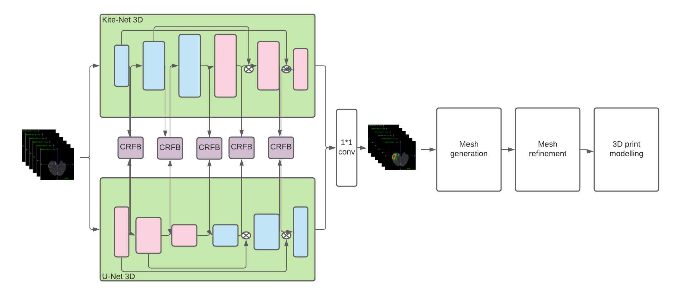
Overall architecture

Slide 6
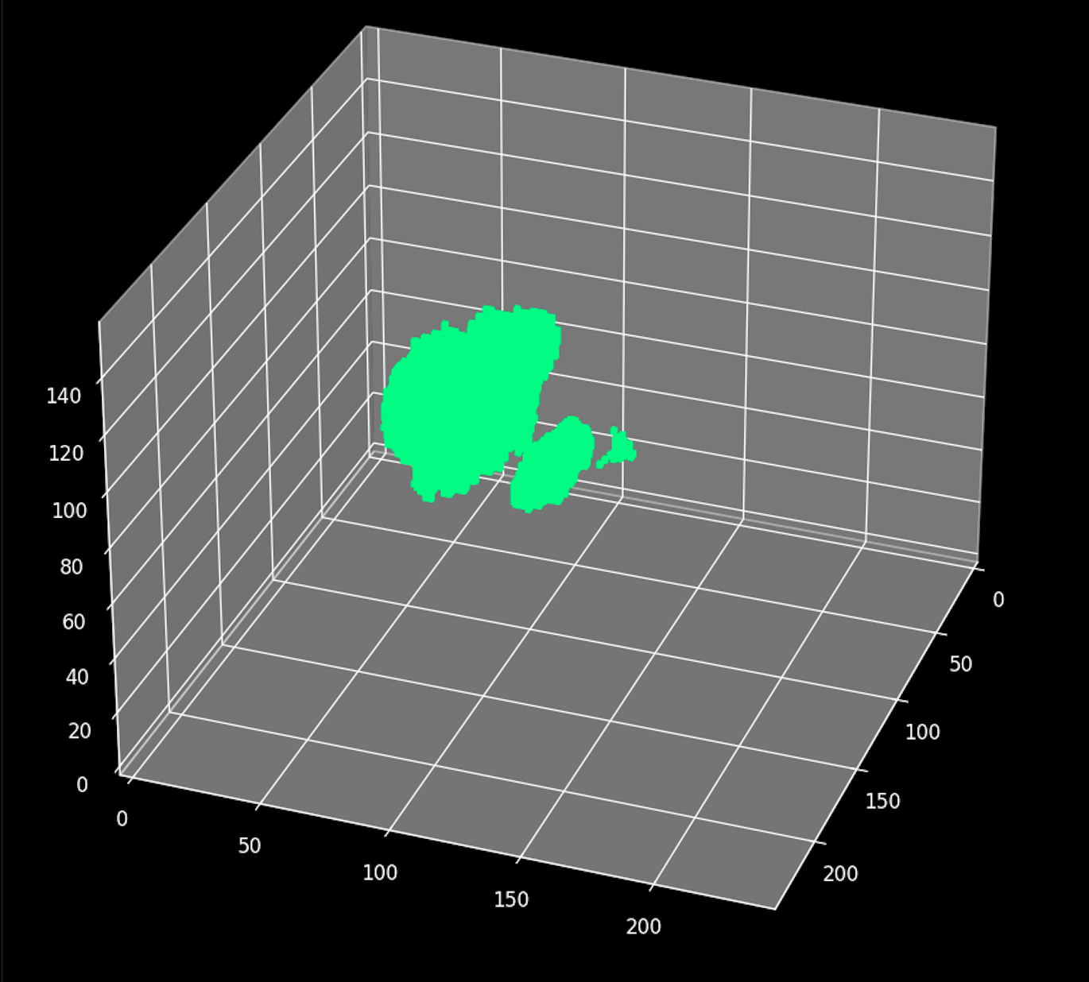
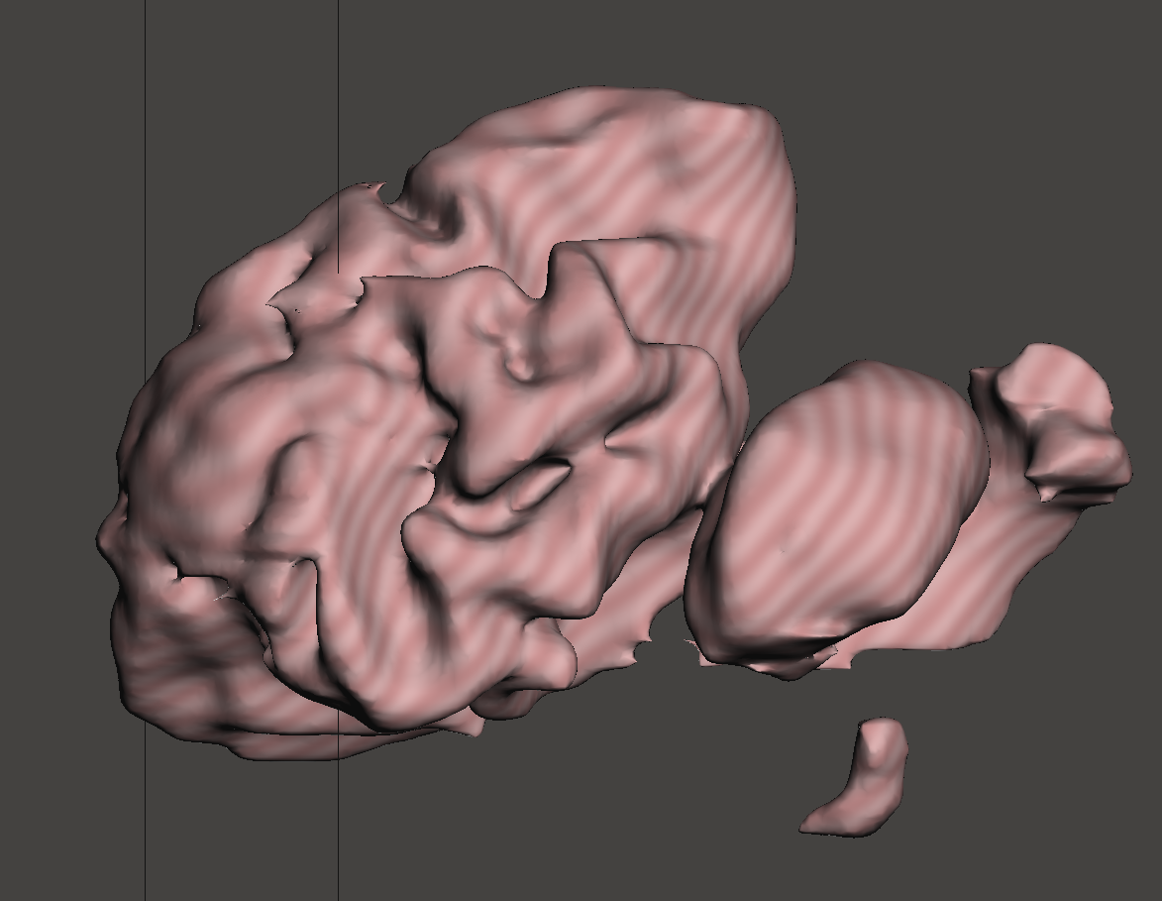
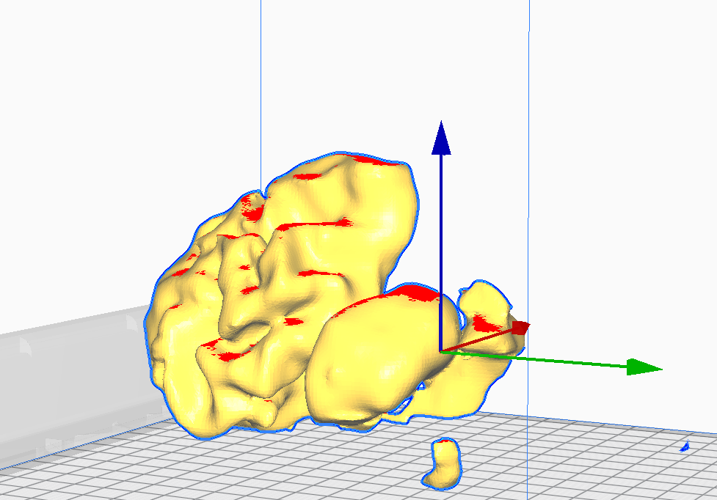
Deliverables at each stage of the project
Module 1 - Segmented tumor
Module 2 - Mesh refined tumor
Module 3 - 3D modeling
The module takes in processed MRI image data and delivers raw unprocessed segmented tumor
The unprocessed tumor is full of errors and this module delivers clean, smooth and error-free mesh object
The clean mesh file is processed to be capable of 3D printing and also made customizable for chosen 3D printer

Slide 7
Dataset

Slide 8
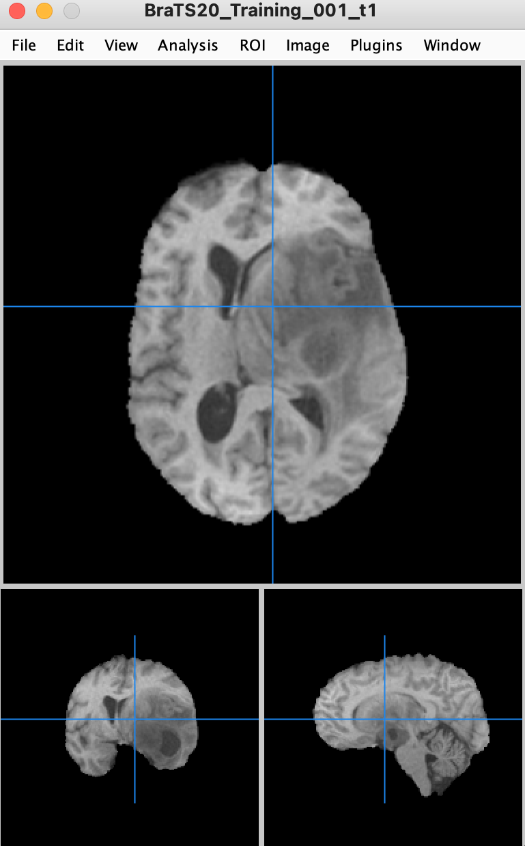
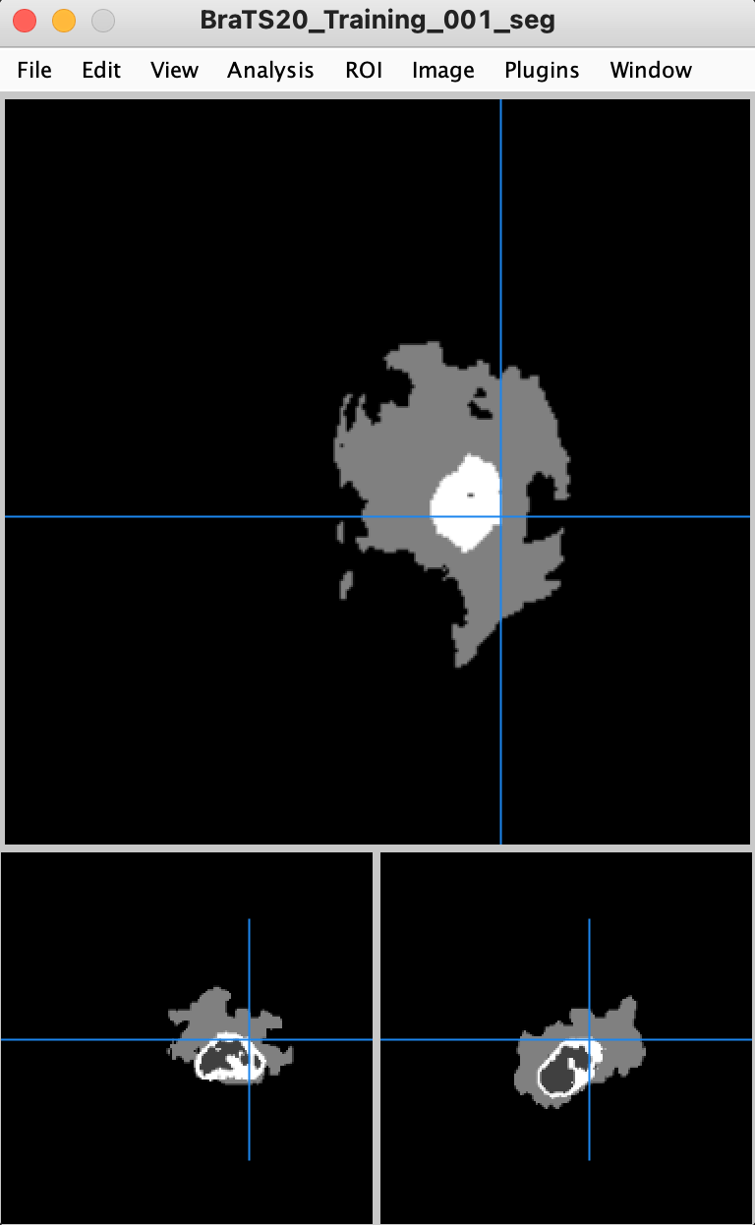
Files and folder included in the dataset
Acquiring the dataset involves following certain procedures and it is provided as 2 folders namely, Training and Validation. Each folder consists of several sub-folders each of which corresponds to the input scans of a single sample. Inside these folders are several contrasts of the sample considered. The training set addiontially consists of the tumor segment for training the model whereas the validation folder doesn’t contain any of those
BRATS
The 3D scans in MRI format provided as a part of the MICCAI BraTS challenge
Image contrasts
FLAIR
T1
T1CE
T2

Slide 9
Segmentation architecture
Dataset

Slide 10
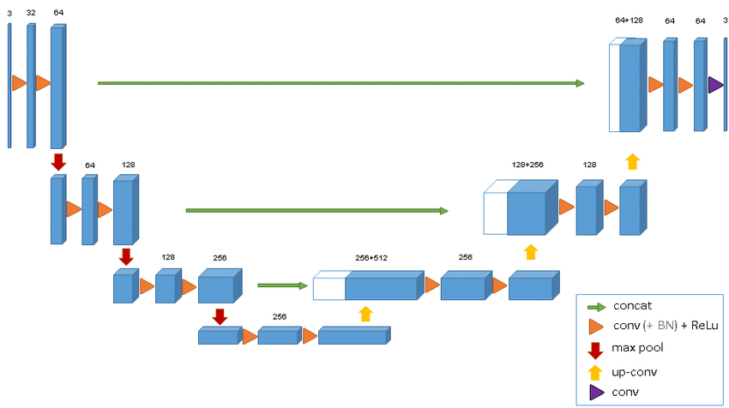
U-Net 3D

Slide 11
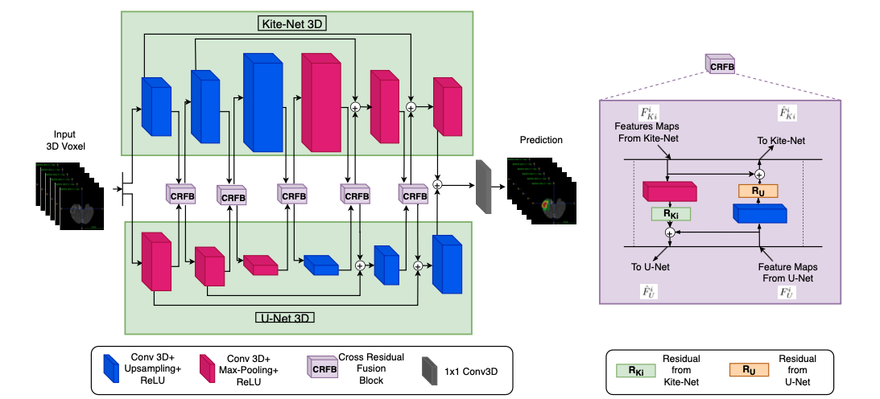
KiU-Net 3D

Slide 12
Implementation
Segmentation architecture
Dataset

Slide 13
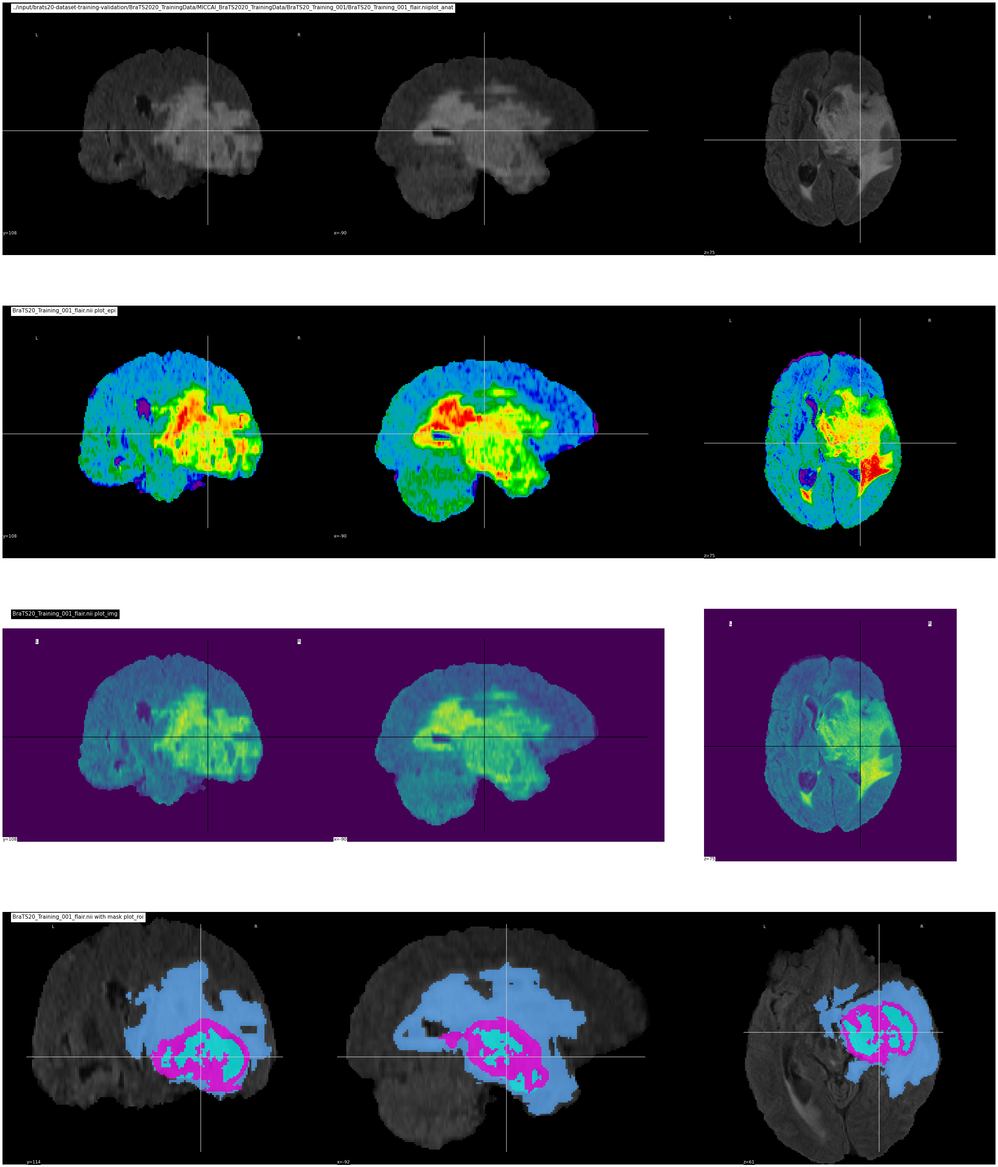
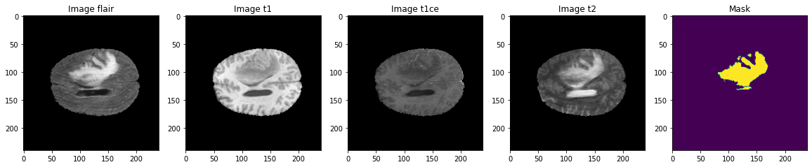
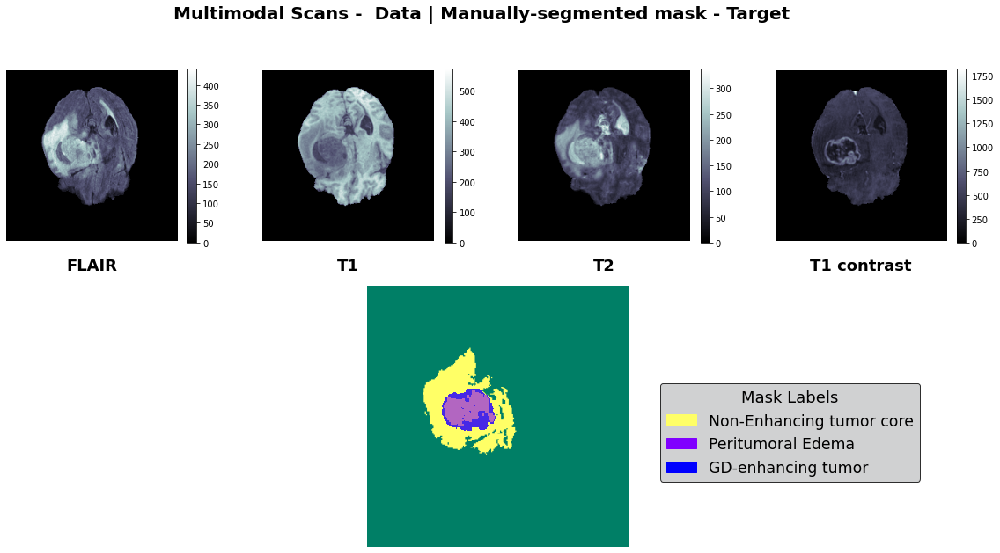
Input visualization

Slide 14
Image processing
1
Load the input image
4
Stack
2
Resize
5
Augment
Preprocess mask labels
3
Normalize
6

Slide 15
Data-loader
Input, parameters & Outputs
Further processing on dataloader
Input - processed data
Parameters - batch_size : 1
shuffle : True
num_workers : 4
Output - Dataloader for model training
The iter() function is used to transform the dataloader into an iterable object and the next() function is used to access the generated iterable object. Every element of the extracted iteratable object comprises of the “Image_ID” and the torch tensors of stacked input image and the segment
Final dimensions
Stacked input image tensor - torch.Size([1, 4, 155, 240, 240])
Stacked input mask tensor - torch.Size([1, 3, 155, 240, 240]))

Slide 16
Training the model
Transfer learning employed - Brats20logs
The plots for accuracy score, loss and the performance metrics are also defined in the same “Trainer” class
Hyperparameters for model training
Optimization function - Adam
Learning rate - 5e-4 i.e., 5 x 10 ⁻⁴
Scheduler - ReduceLROnPlateau
Number of epochs - 10
Accumulation steps - 4

Slide 17
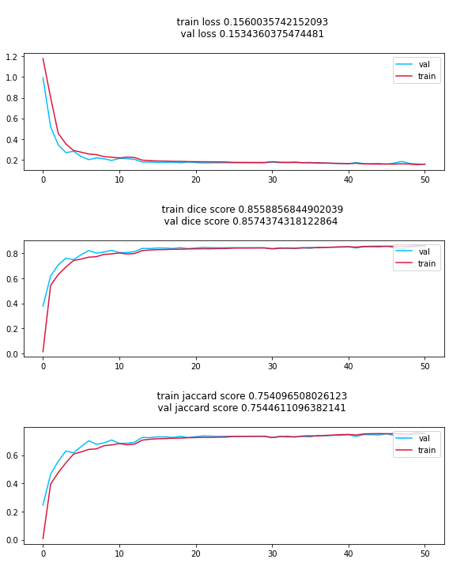
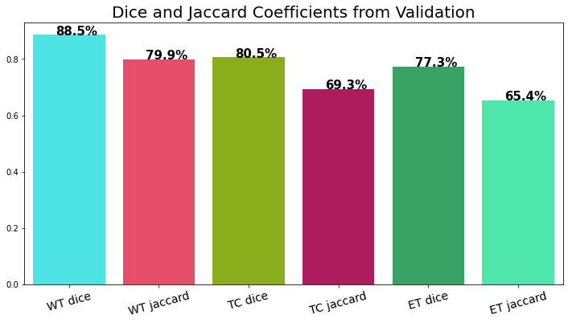
Scores and accuracy plots
Dice coefficient (DICE) - 2 * the Area of Overlap divided by the total number of pixels in both
images
Jaccard (JAC) - The Intersection over Union (IoU) metric, is essentially a method to quantify the percent overlap between the target mask and our prediction output. This metric is closely related to the Dice coefficient which is often used as a loss function during training.
$$DICE=\frac{2|(S_{g})^{1}∪(s_{t})^{1}|}{|(S_{g})^{1}|+|(S_{t})^{1}|}=\frac{2TP}{2TP+FP+FN}$$
$$JAC=\frac{|(S_{g})^{1}∩(S_{t})^{1}|}{|(S_{g})^{1}∪(S_{t})^{1}|}=\frac{TP}{TP+FP+FN}$$

Slide 18
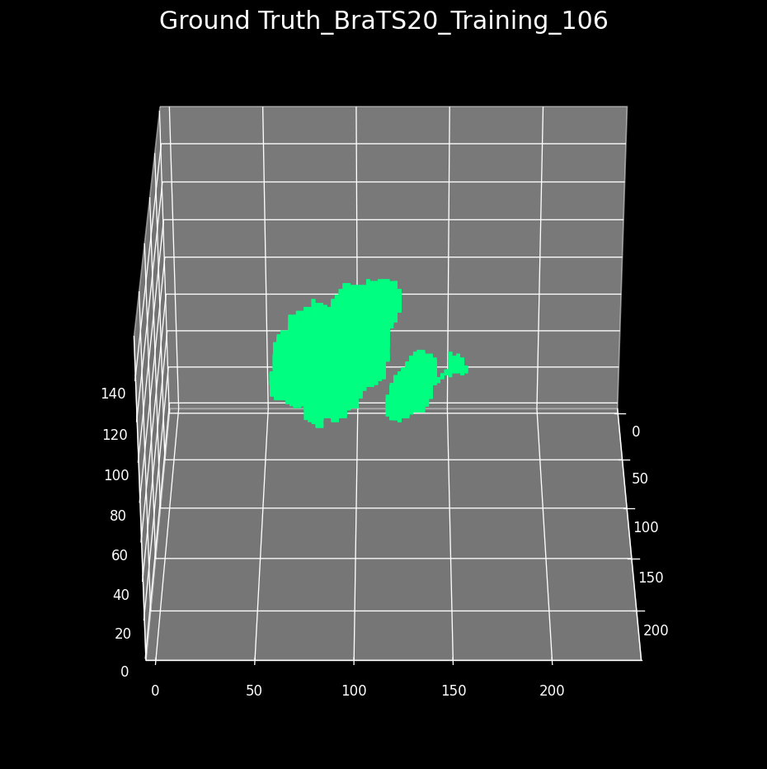
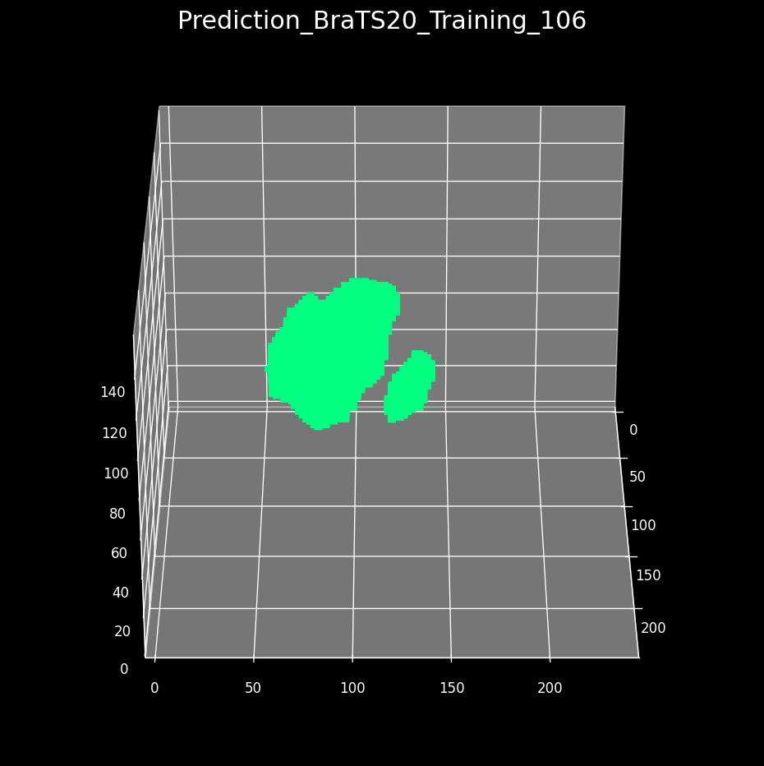
Output (Tumor) visualization

Slide 19
Mesh generation & refinement
Segmentation architecture
Input visualization & processing
Dataset

Slide 20
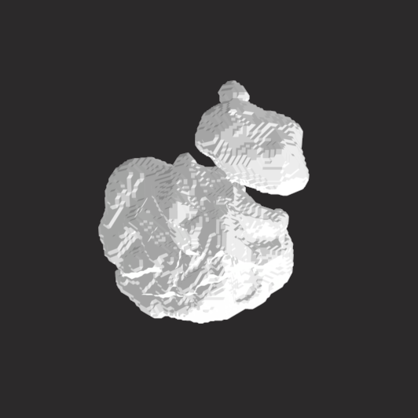
Mesh generation
The raw segmented tumor in the form of a torch tensor is initially converted into 3D numpy array
The vertices and faces of the 3D image in numb array is extracted with the help of “meshplot” library
These vertices and faces are then used to create a mesh object with the help of “dataToMesh” function from the same library and the 3D object is saved with “.stl” extension

Slide 21
Procedures in mesh refinement
1
Making the surface of the mesh smoother - the degree of smoothness is customizable for different portions of the mesh object
2
Topology of the mesh object improved by adjusting the mesh density
3
Further techniques for smoothing the surface like, “global smoothing” and “Robust smooth” removes step artifacts due to finite voxel size
4
The unphysiological holes in the mesh object was removed with the help of “Flatten” and “Inflate” brushes

Slide 22
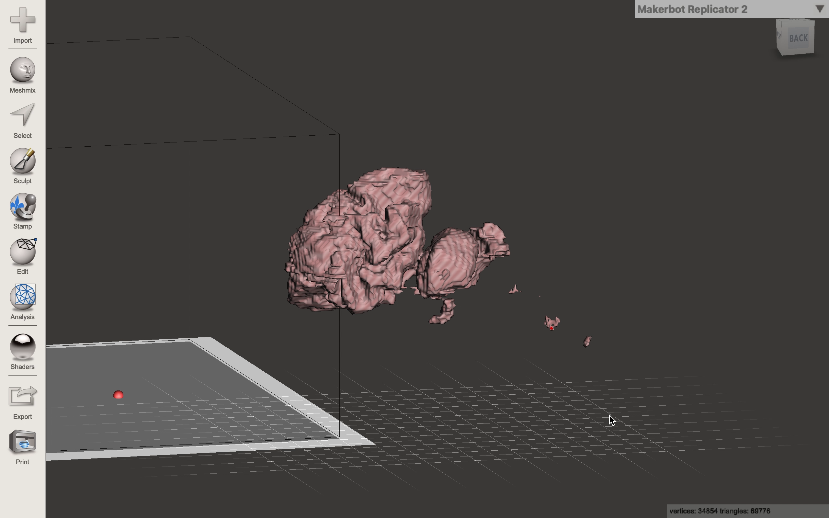

Slide 23
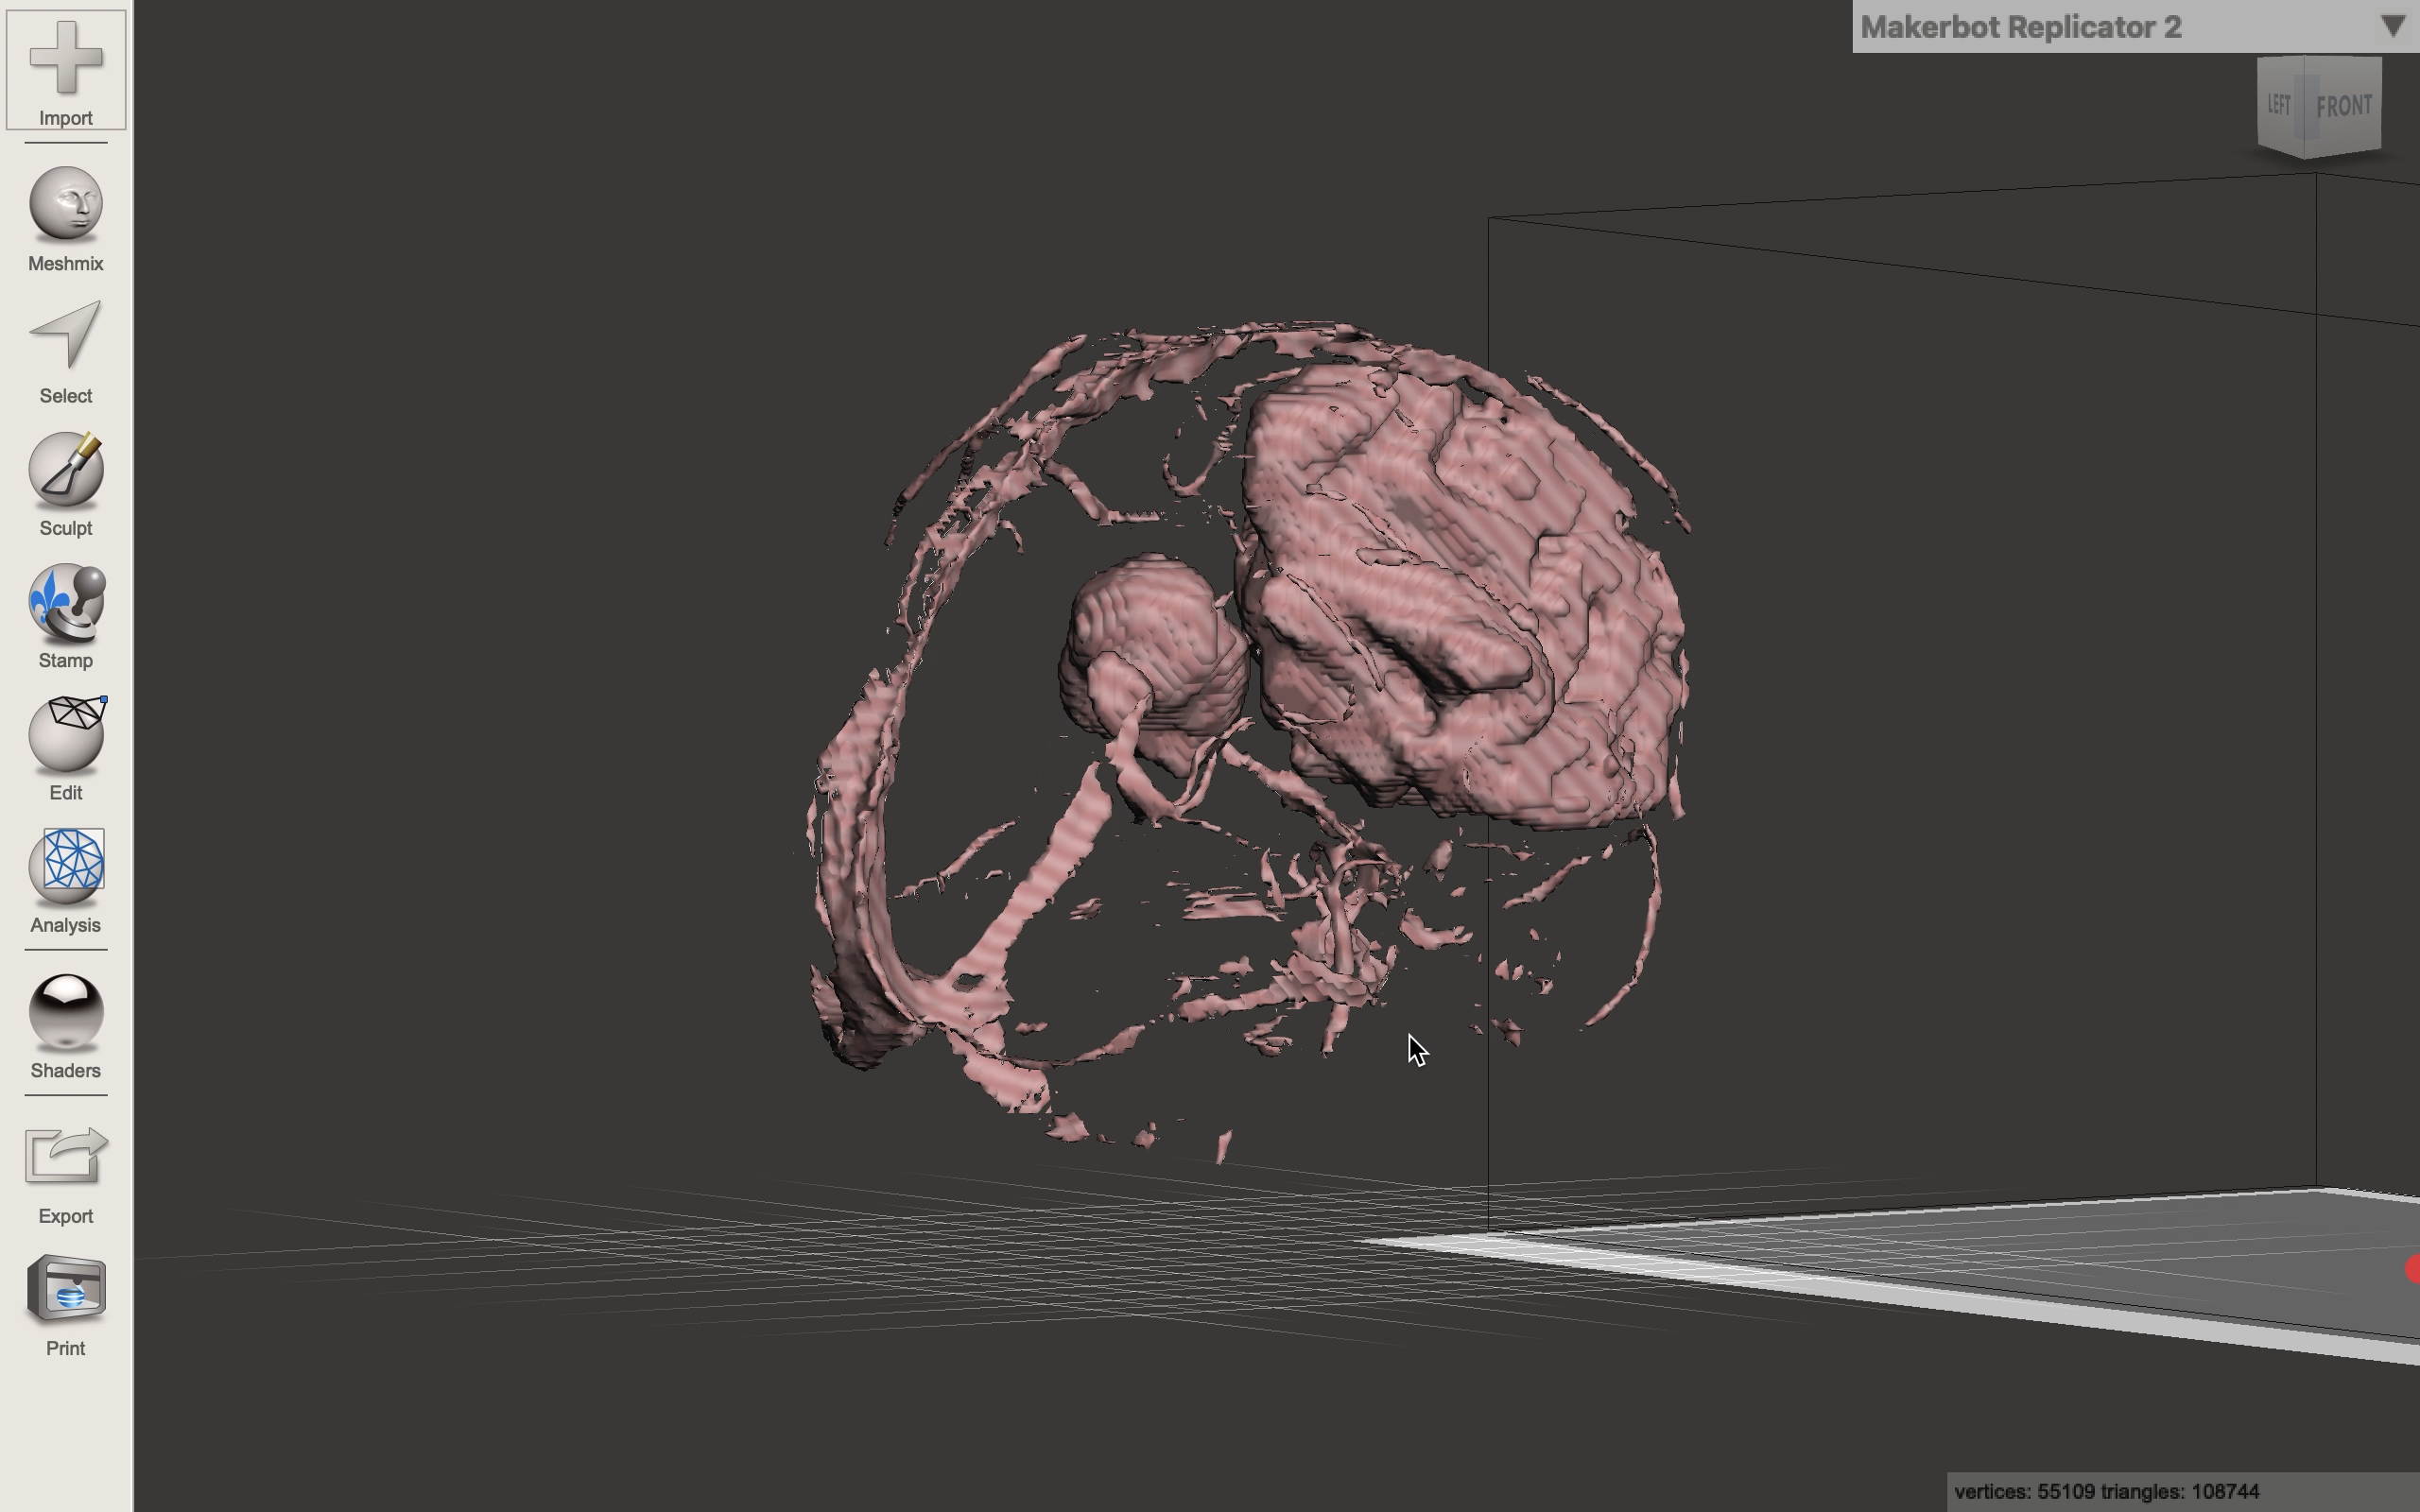

Slide 24

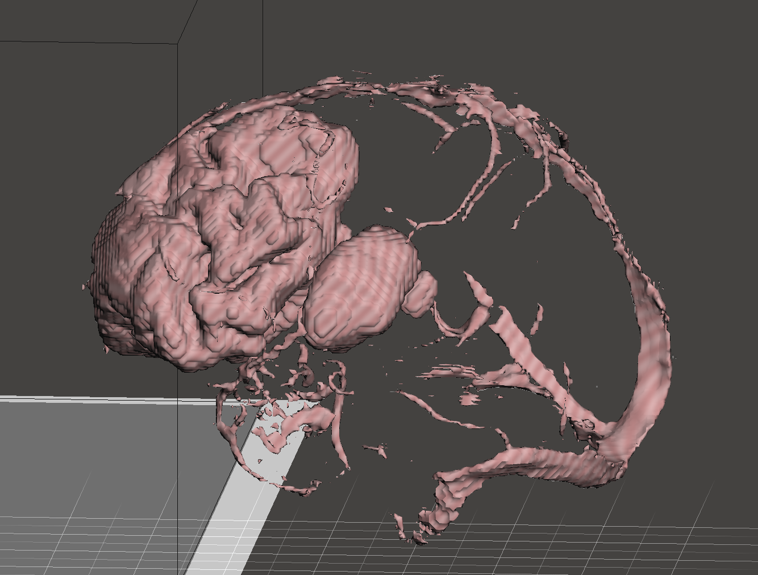
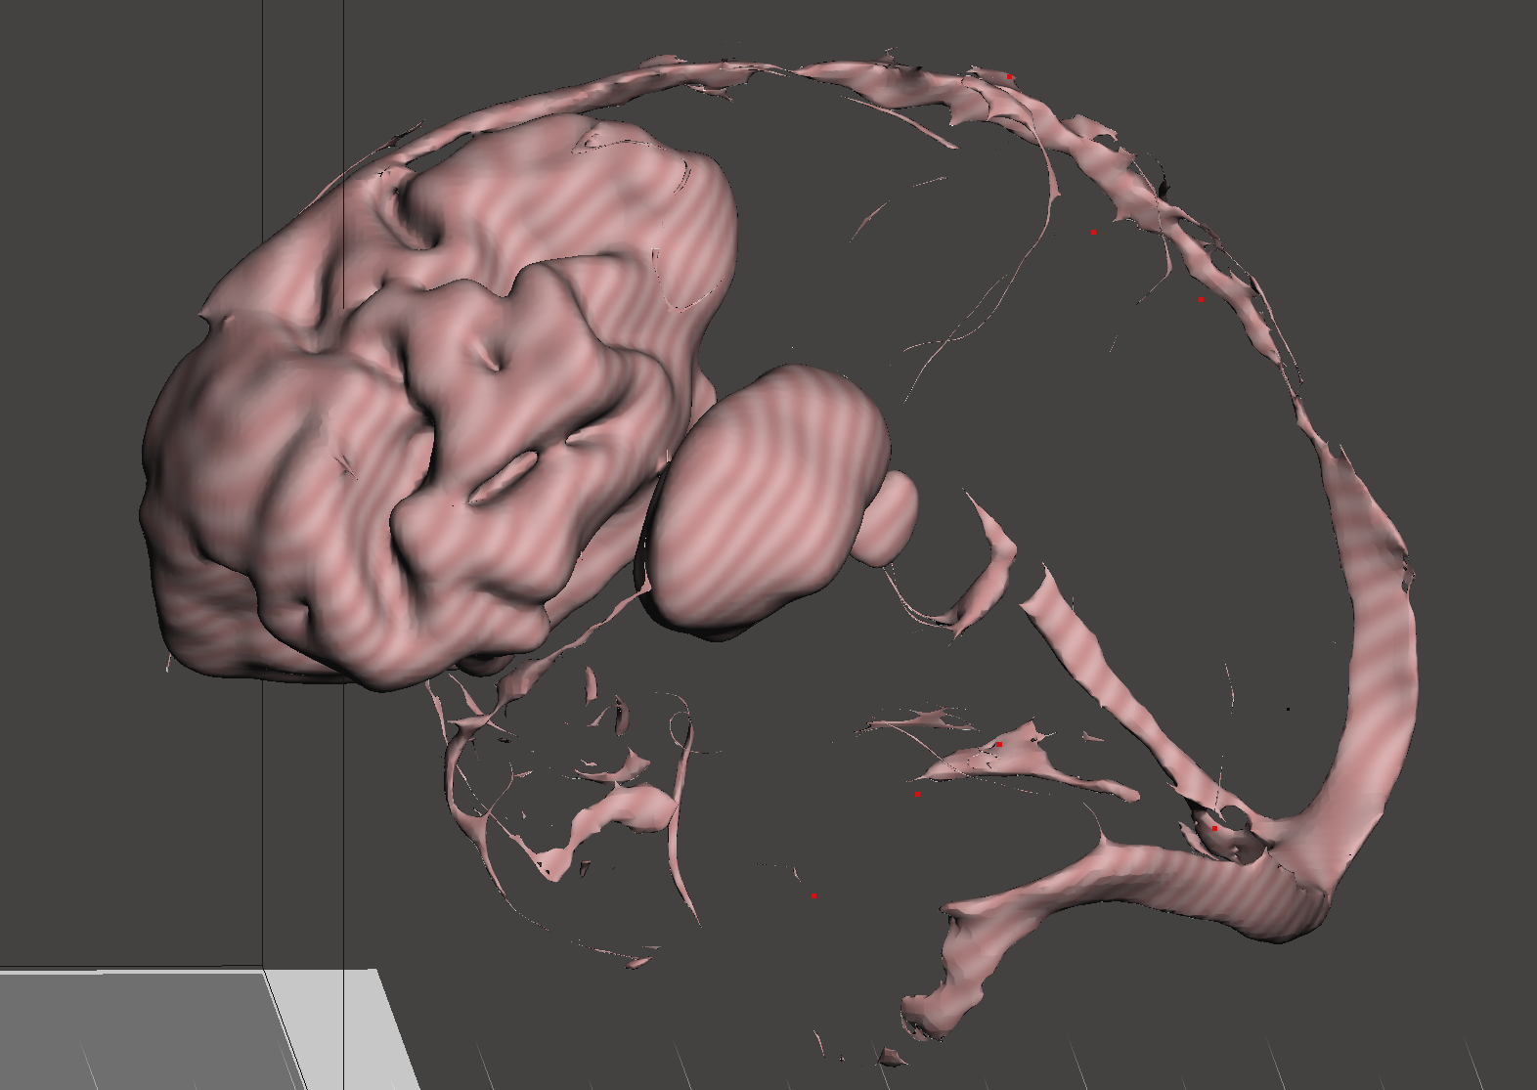
Realizing the importance of mesh refinement

Slide 25
3D model generation & visualizations
Mesh generation & refinement
Segmentation architecture
Input visualization & processing
Dataset

Slide 26
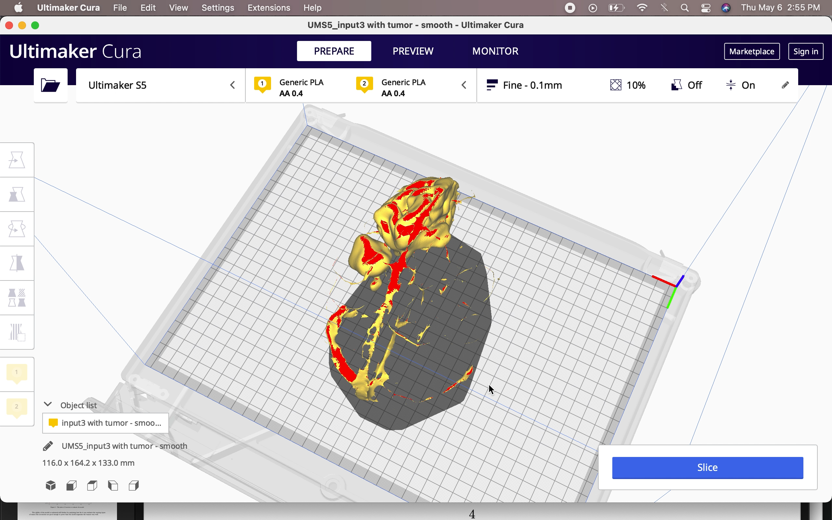
3D model in CURA software
Making small corrections in the cleaned mesh file
Customizing the layer height
Adjusting the thickness (top, bottom)
Providing the infill percentage for portions of the 3D model
Deciding the required print material

Slide 27
Intricate analysis of
tumor
Having analyzed now well the model can segment each class of tumor, that capability can be considered as very helpful for intricate analysis of the tumor. The 3D modeling can be very useful for such purposes.

Slide 28
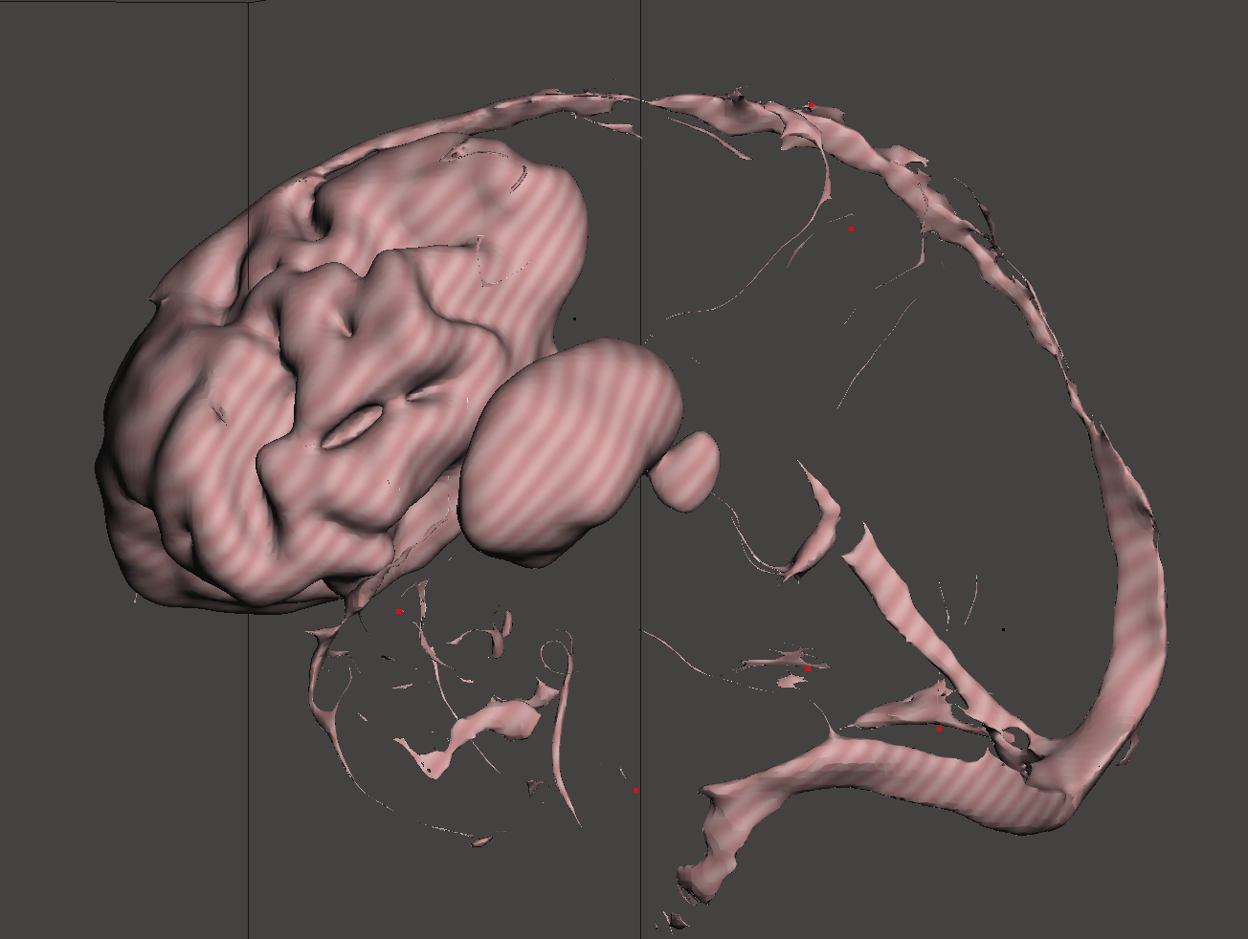
Locating the position of tumor
The t2 contrasted input file and the segmented tumor was taken
The torch tensor was converted into normal 3D numpy array
Both the array were combined into one and the combined file was converted into mesh
The mesh was cleaned and 3D modeled

Slide 29
Concluding remarks
3D model generation & visualizations
Mesh generation & refinement
Implementation
Segmentation architecture
Dataset

Slide 30
Importance of each module
Each module though is crucial to make up the entire project has its contribution at different proportions. As the pie chart suggests, almost 60% of the importance should be given to the segmentation module, since it forms the base for the rest of the 2 modules. Next in priority is the “Mesh refinement” module, which is crucial for rendering clean, error free 3D models. Last comes, the model generation.

Slide 31
Targeted end users
Anatomy students
Doctors
Affected patients

Slide 32
THANK YOU

